Slide 1


Minor Project (Semester VI)
Title : Stock Price Prediction
Presented by:
Name | SAP ID | Specialization
Jerem Lee | 500095190 | AIML (NH)
Nij Gadwal | 500094897 | AIML (NH)
Pasupuleti Jayasai | 500095655 | AIML (NH)
Garvit Sharda | 500093671 | AIML (H)

Slide 2


Content
Introduction
Literature Review
Objectives
Methodology
References

Slide 3
Introduction
Stock prediction is vital for investment choices.
LSTM neural networks excel at capturing complex patterns in stock market data.
This study aims to enhance predictive analytics in finance using LSTM-based models.
Technical Concepts (Algorithms) used :
Utilizing LSTM neural networks in stock price prediction projects involves leveraging their ability to capture long-term dependencies and sequential patterns in time series data for more accurate forecasting.
Motivation :
Efficiency and Accuracy
Customer Convenience
Cost reduction
Customer Feedback
Problem Statement :
Stock price prediction is hindered by the dynamic, non-linear nature of market data, posing challenges for traditional forecasting methods. This complexity concerns investors and institutions relying on accurate predictions for informed decisions and risk management.

Slide 4
Introduction
Area of application
This project's application lies in financial markets, where accurate stock price prediction can inform investment decisions and mitigate risks for investors and institutions.
Dataset
Stock-MArket-Forecasting-Dataset

Slide 5
Literature Review
Cite Related work
1. Hochreiter and Schmidhuber's "Long Short-Term Memory" (1997) - This is the first study that introduces LSTM networks and establishes the framework for using them in sequence prediction tasks.
2. Goyal et al. (2017) "Stock price prediction using LSTM, RNN, and CNN-sliding window model" This research investigates the use of LSTM and other neural network designs for sliding window-based stock price prediction.
3. Fischer and Krauss (2018) present "A deep learning framework for financial time series using stacked autoencoders and long-short term memory" - This paper improves the feature extraction and prediction of financial time series data by combining LSTM networks with stacked autoencoders.

Slide 6
Literature Review
SWOT analysis
Strengths:
Data Availability
Advanced Algorithms
Technological Tools
Market Insights
Weaknesses:
Market Volatility
Model Complexity
Overfitting
Black Swan occurrences
Opportunities:
Big Data Analytics
Alternative Data Sources
Real-Time Prediction
Interdisciplinary Research
Threats:
Regulatory Risks
Competition
Data security and privacy
Interpretability of the Model
Ethical Concerns

Slide 7
Objective
Main Objective
Examine extensive literature on LSTM network methodologies for stock price prediction, with a particular emphasis on the use of LSTM networks in finance.
Prepare and train historical stock market data (prices, volumes, etc.) for model training and assessment.
Design and deploy LSTM based stock price forecasting models, taking advantage of the network’s ability to capture temporal relationships and non-linear trends.
Analyze the performance of the model using appropriate metrics (MAE, RMSE).

Slide 8
Methodology
Reference Software model
Spiral Model
Steps
Data collection
Data preprocessing
Feature engineering
Sequence Generation
Model Construction
Model Training
Prediction
Fine-tuning and Optimization
Deployment and Monitoring

Slide 9
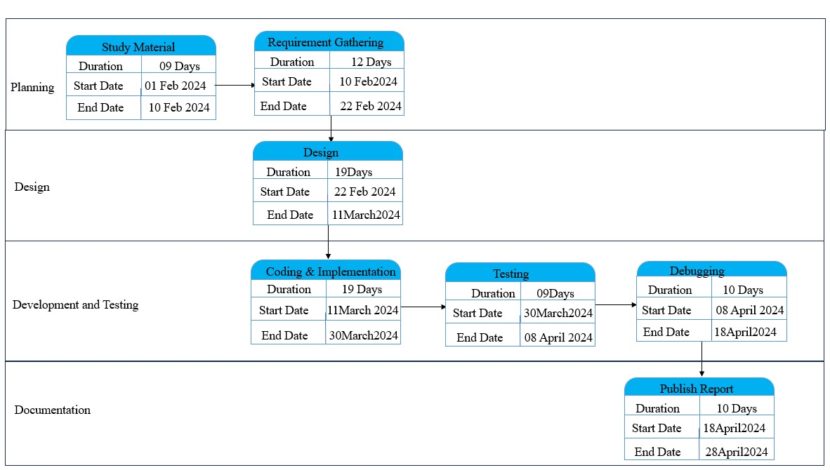
Methodology
Timeline

Slide 10
References
List of cited Research papers
Addison, P. S. (2002). The illustrated wavelet transform handbook. Napier University.Avramov, D. (2002). Stock returns predictability and model uncertainty. Journal of Financial Economics, 64, 423–458.
Brock, W., Lakonishok, J., & LeBaron, B. (1992). Simple technical trading rules and the stochastic properties of stock returns. The Journal of Finance, 47, 1731–1764.
Campbell, J. Y., & Thompson, S. B. (2008). Predicting excess stock returns out of sample: Can anything beat the historical average? Review of Financial Studies, 21,1509–1531.

Slide 11
References
List of Related Articles
Campbell, J. Y., & Vuolteenaho, T. (2004). Bad beta, good beta. The American Economic Review, 94, 1249–1275.
Chen, J., Jiang, F., & Tong, G. (2017). Economic policy uncertainty in China and stock market expected returns. Accounting and Finance, 57, 1265–1286.
Clark, T. E., & West, K. D. (2007). Approximately normal tests for equal predictive accuracy in nested models. Journal of Econometrics, 138, 291–311.

Slide 12

Thank You

